Slide 1
.NET Aspire

Slide 2
.NET Cloud Native
.NET has had the aspirational goal of being the most productive platform for building Cloud Native apps for some time.
Health Checks
Kestrel
HTTP Client Factory
Polly
gRPC
YARP
Container Builds
Native AoT

Slide 3
But we can do more…

Slide 4


How we got here: Customer feedback
“It’s not just that I have too many Lego bricks to choose from, I’m not sure I’m even putting the Lego blocks together correctly”
“Every developer on my team now needs to be an expert in networking, containers, telemetry systems, etc. It never used to be that way and it slows down everything we do.”
“Nothing works together by default.”

Slide 5
How we got here: 1st Party
After evaluating large amounts of internal libraries written to help teams build services with millions of active users, we observed that these libraries fell into 2 broad categories:
Libraries filling gaps or enhancing our existing libraries
Wrapper libraries that took a dependency and shimmed it
Libraries like log redaction and resiliency
These all became candidates to ship publicly, and we are shipping some of them with .NET 8
Customize a dependency or wrap it to meet the team’s needs
Configure or wrap Polly, or Redis connections
Integrate w/ASP.NET Core DI

Slide 6
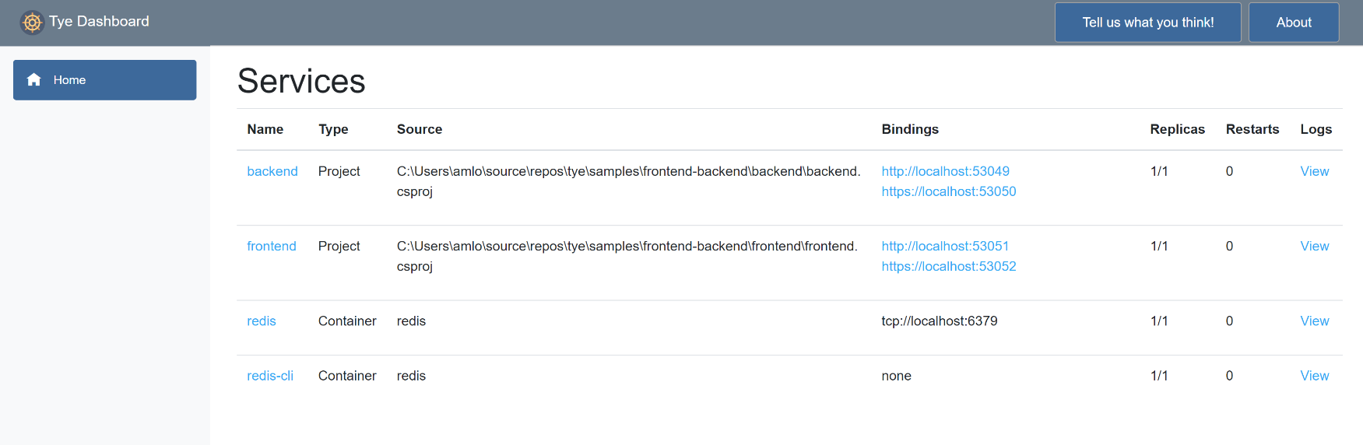

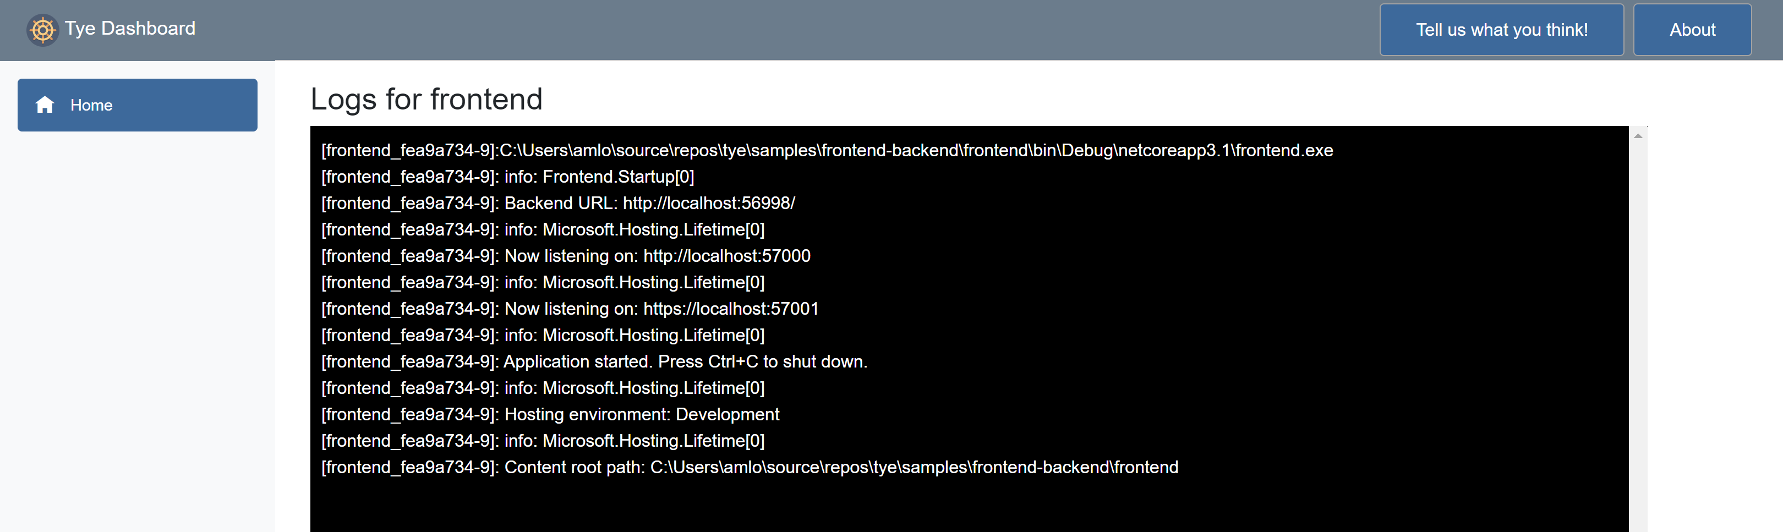
How we got here: Experiments
Project Tye
Goal: Make building and deploying .NET cloud apps running on Kubernetes trivial.
Customer Experience:
YAML file to describe solution/topology
Tye could run external container dependencies (Redis, Postgres)
Developer dashboard
Run as containers or processes
Deploy directly to K8S via a temporary manifest
Reaction: People loved the developer experience – orchestration, containerization, the dashboard – but saw no real value in the K8S deployment part.

Slide 7

Running distributed applications in your local development environment is hard

Slide 8
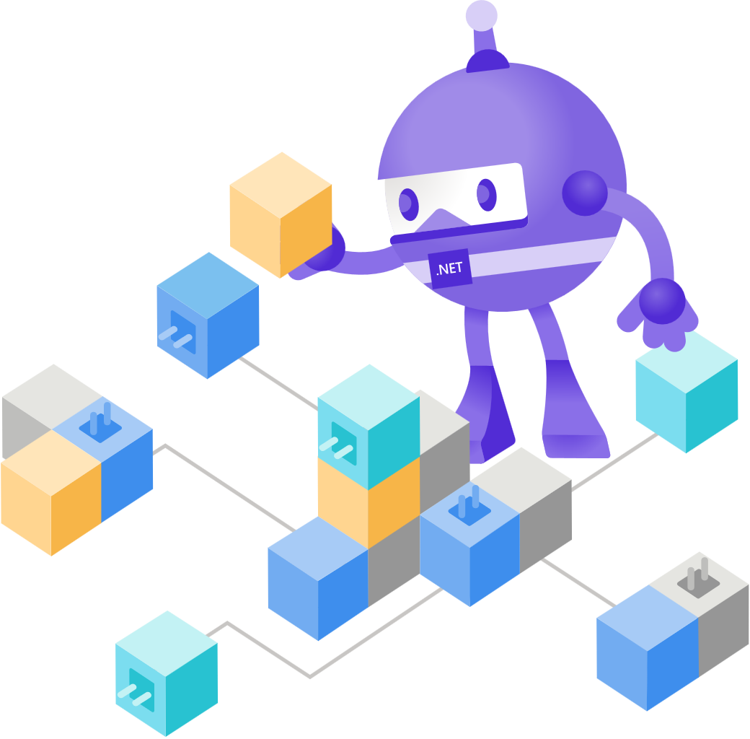
How do I setup monitoring for all my code? Logging? Console scraping? OpenTelemetry? APM?
How do I get my frontend to talk my API? What is the port? What is the URL? Does it do HTTPS?
How do I run Redis locally when I am using a caching service in production?
How do I run all the projects locally to test if the end-to-end works?
I hate it here.
How do I know what config options I need to set for production?
How do I know that all these libraries are supposed to work together and are good in the cloud?
What is the right resiliency Policy? Retries? Exponential Backoff? How many retries? Do the libraries retry as well?

Slide 9
.NET Aspire is a stack for building resilient, observable, and configurable cloud-native applications with .NET
.NET Aspire includes a curated set of components enhanced for cloud-native fundamentals including Telemetry, Resilience, Configuration, Health Checks, and Composition
.NET Aspire makes it easy to discover, acquire, and configure essential dependencies for cloud-native applications on day 1 and day 100

Slide 10
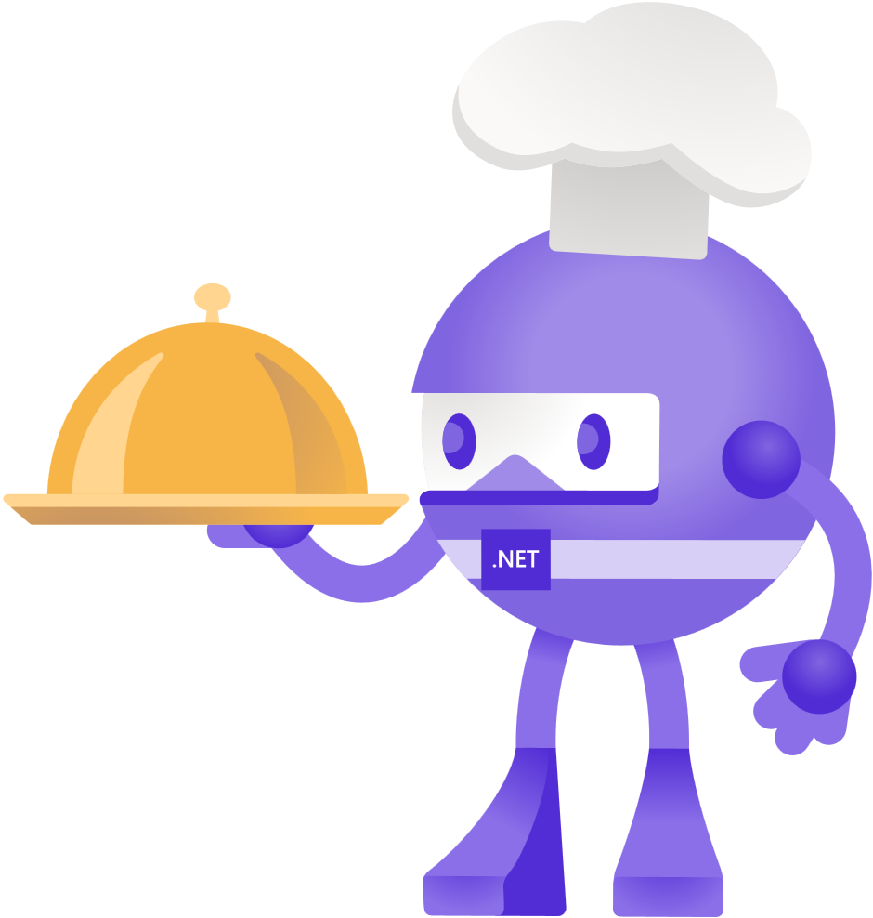
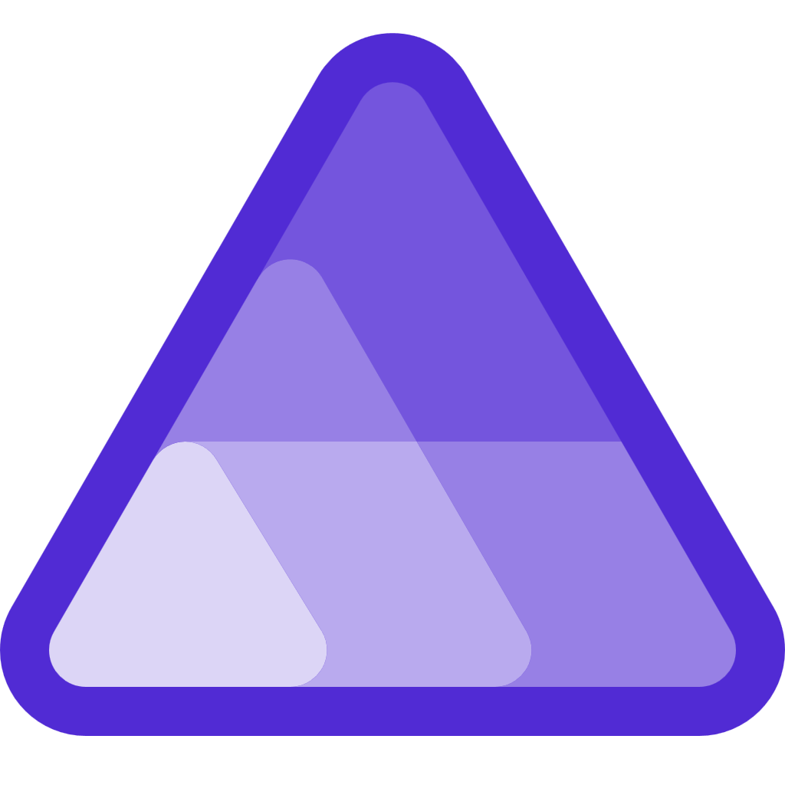
Introducing .NET Aspire

Slide 11
Demo

Slide 12




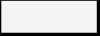


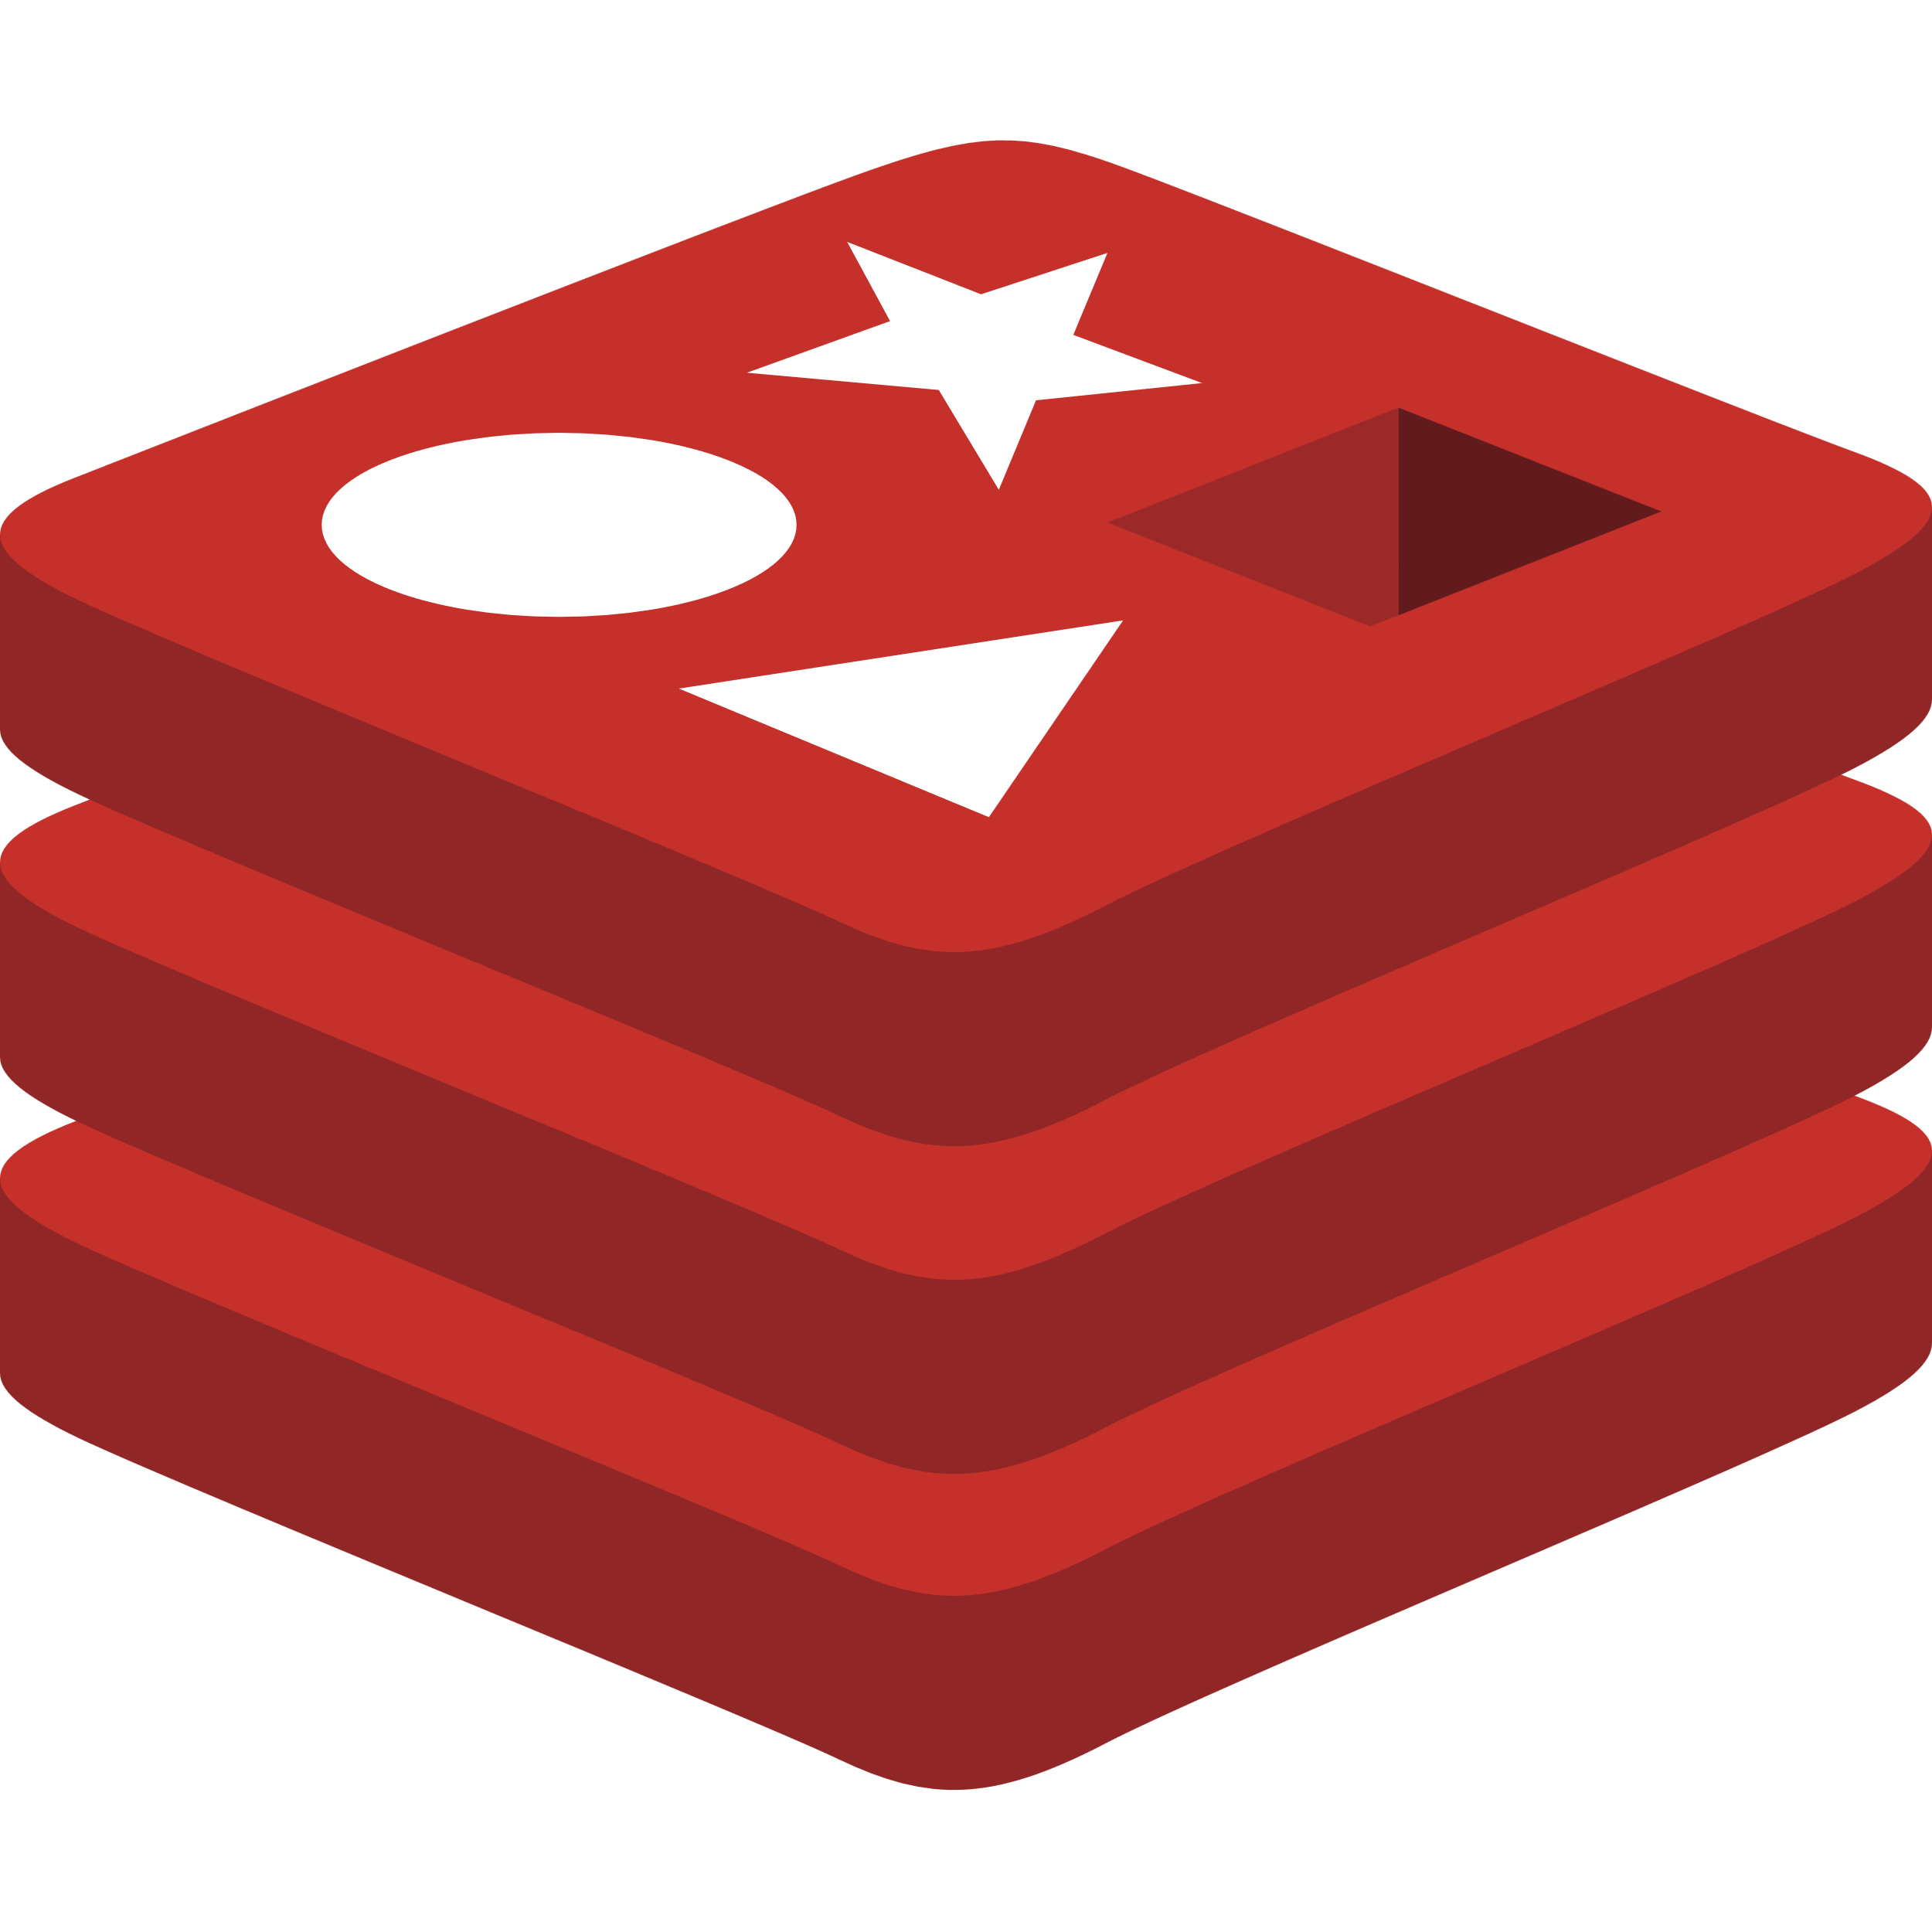
App Model
Orchestrates resources in your dev environment
Projects, containers, executables, live dependencies
Grows with you:
From a single web app with a database to many microservices and their dependencies.
Can generate a manifest that can be examined by other process, such as deployment pipelines or tooling.
Identity Service
Mobile BFF
Identity API
PostgreSQL
OpenAI
Mobile API
Catalog Service
Catalog API
PostgreSQL
Order Service
Ordering API
Web App
Ordering API
PostgreSQL
Order Processor
Event Bus
Blazor App
Basket Service
Basket API
Redis
Payment Service
Payment Processor
Notes:
NOTE: In the future having at least a 3 frame animation for the microservices slide to go from app with database to n-tier to microservices

Slide 13



Aspire component spec/requirements
Telemetry (metrics, logs, distributed tracing)
Secrets management
Health Checks
Quality documentation
Configurable
Servicing & secure supply chain guidance
Composition
Resilience

Slide 14
Aspire Components Preview List
Aspire.Data.SqlClient
Aspire.EF.SqlServer
Aspire.EF.PostgreSQL
Aspire.Npgsql
Aspire.StackExchange.Redis
Aspire.SE.Redis.OutputCaching
Aspire.SE.Redis.DistributedCaching
Azure.Data.Tables
Azure.Messaging.ServiceBus
Azure.Security.KeyVault
Azure.Storage.Blobs
Azure.Storage.Queues

Slide 15
Roadmap
Preview 1 now
Monthly previews
GA in the spring

Slide 16
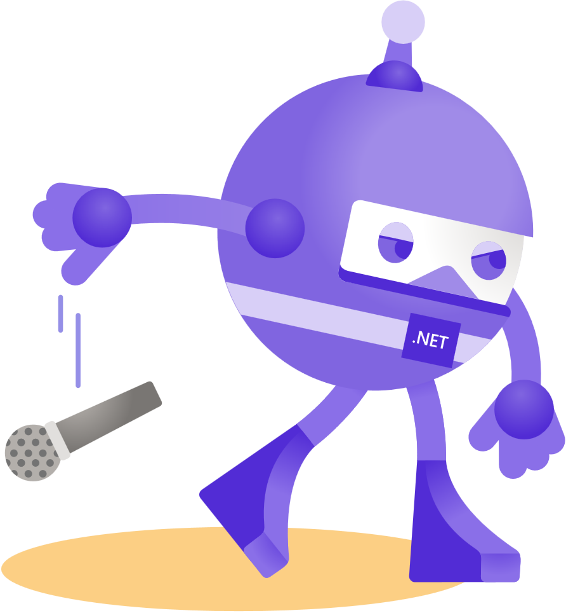
Thanks for joining!

Slide 17

Resources
Download .NET 8 aka.ms/get-dotnet-8
Aspire Github http://github.com/dotnet/aspire
Aspire Samples https://github.com/dotnet/aspire-samples

Slide 18
Download .NET 8
https://aka.ms/get-dotnet-8

Slide 19
App Model
Orchestrates resources in your dev environment
Projects, containers, executables, live dependencies
Grows with you:
From a single web app with a database to many microservices and their dependencies.
Can generate a manifest that can be examined by other process, such as deployment pipelines or tooling.
Notes:
NOTE: In the future having at least a 3 frame animation for the microservices slide to go from app with database to n-tier to microservices

Slide 20
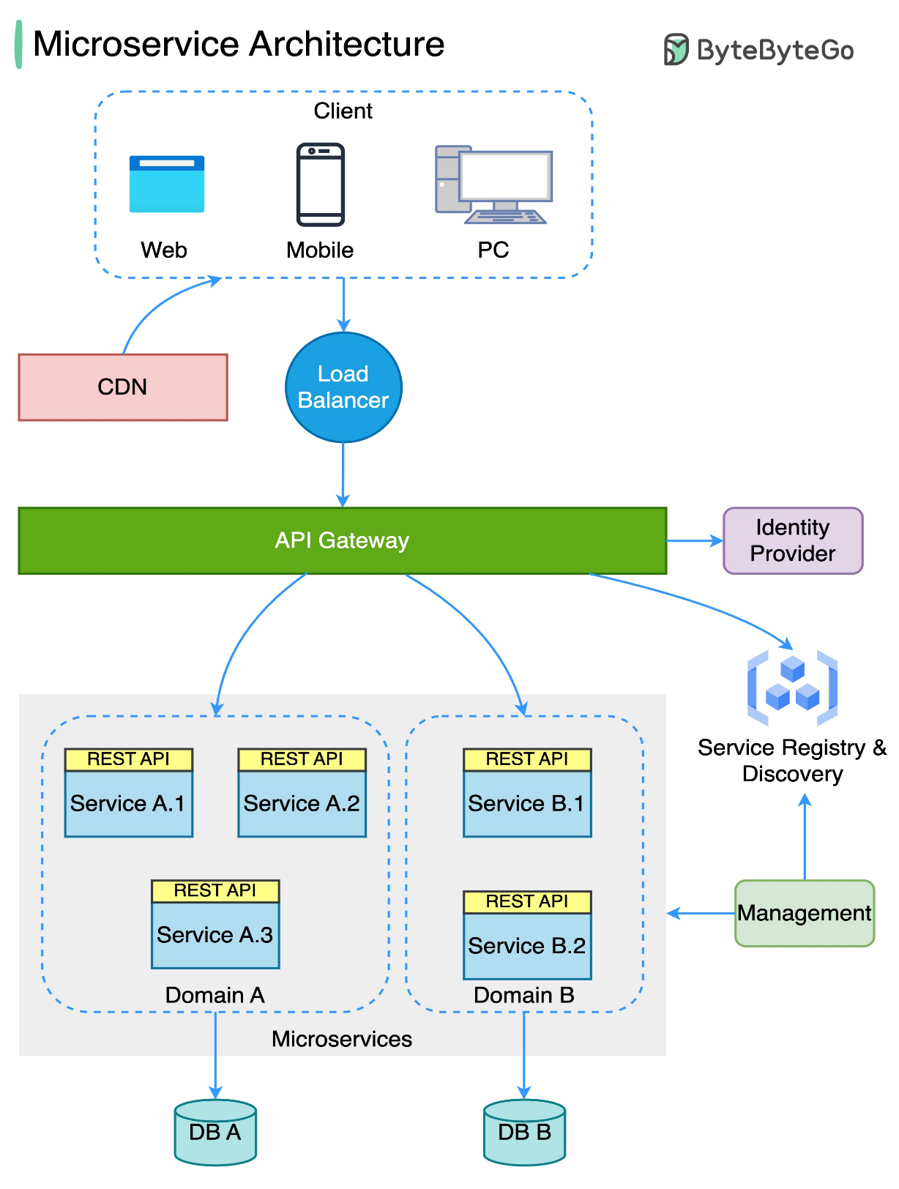
App Model
Orchestrates resources in your dev environment
Projects, containers, executables, live dependencies
Grows with you:
From a single web app with a database to many microservices and their dependencies.
Can generate a manifest that can be examined by other process, such as deployment pipelines or tooling.
Notes:
NOTE: In the future having at least a 3 frame animation for the microservices slide to go from app with database to n-tier to microservices

